Slide 1
Speeding-up Reinforcement Learning using Prioritized Sweeping
Project title: Speeding up Reinforcement Learning using model-building techniques and Prioritized Sweeping
Thijs Ramakers
Supervisors:
prof. dr. R. Babuška, dr. G. Lopes, E. Schuitema M.Sc
MSc Workshop, February 26, 2010
Delft Center for Systems and Control
Notes:
Hello everybody, thanks for being present here.
Introduction to by Msc thesis, titled ‘speeding up reinforcement learning using prioritized sweeping and model-building techniques’

Slide 2
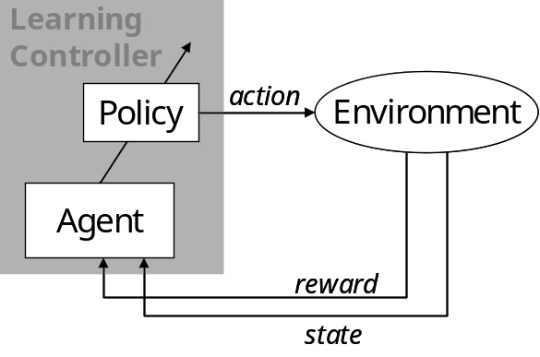
Reinforcement Learning
Learning by trial-and-error
Repeat for all states:
Try an action
Receive reward/punishment
Update (learn) value Q(s,a)
February 26, 2010
Notes:
RL problems can be solved for relatively simple problems. For larger problems, learning becomes slow due to:
Continuous states. VF has to be approximated and a state is never encountered twice.
High number of dimensions: leads to a very high number of states. Makes it very difficult to determine VF for the total state-space
Slow propagation of information: Once the goal is found, this information propagates through the state-space very slowly.
This last problem is dealt with in the work.

Slide 3
Solving a Reinforcement Learning problem
Solution: Find value function for the entire state-space
Method: By using a model or by interaction with real setup
Problem:
State-space is very large
Relatively few experiences with real setups
(one state-transition per sampling interval)
February 26, 2010
Notes:
RL problems can be solved for relatively simple problems. For larger problems, learning becomes slow due to:
Continuous states. VF has to be approximated and a state is never encountered twice.
High number of dimensions: leads to a very high number of states. Makes it very difficult to determine VF for the total state-space
Slow propagation of information: Once the goal is found, this information propagates through the state-space very slowly.
This last problem is dealt with in the work.

Slide 4

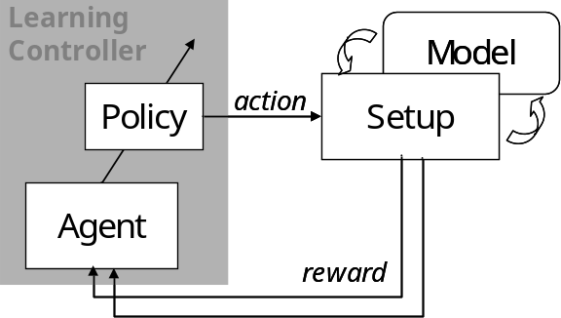
Model-learning approach
No model available, but interaction with setup only is not sufficient
Build a state-transition model:
Use model to re-live experiences
More experiences to fill state-space
Use model and setup simultaneously
state
February 26, 2010
Notes:
Several solution approaches exist. We will focus on the model-learning approach.
Model-learning:
No a priori model is available, but model is learned during the learning process.
Solution method: Switching between on-line (model-free) and off-line (model-based) learning.
The model is used to generate more experiences to learn from. The same update rule is used for the model and the setup. Fill total sample interval with model-based experiences.

Slide 5
Comparison of solving methods
  SARSA (model-free)
  Dyna (model-learning)
  Prioritized Sweeping (model-learning)
February 26, 2010
Notes:
Demands for the model-building technique:
Continuous states
Learning from few observations
Good accuracy (only in parts of state space?)
High dimensional problems
Efficient in CPU/memory usage (has to be applied in real time)

Slide 6


SARSA model-free method
Learning
Learning
Controller
Controller
Policy
Policy
Setup
action
Setup
Dyna
Agent
Learn from interaction with system only
    Observe state-transition
    Receive reward
Explore all the states and actions (exploration rate)
Use experiences to update value function (SARSA-update):
reward
reward
state
February 26, 2010
Notes:
Demands for the model-building technique:
Continuous states
Learning from few observations
Good accuracy (only in parts of state space?)
High dimensional problems
Efficient in CPU/memory usage (has to be applied in real time)

Slide 7
Dyna model-learning method
Learn from interaction with
setup and model simultaneously
  Use real experiences to
      Update value function
      Build state-transition model
  Generate n extra (modelled) experiences per sampling interval
  More experiences per sampling interval to learn from
Learning
Learning
Model
Controller
Model
Controller
Policy
Policy
Setup
action
Setup
Dyna
Agent
reward
reward
state
February 26, 2010
Notes:
Demands for the model-building technique:
Continuous states
Learning from few observations
Good accuracy (only in parts of state space?)
High dimensional problems
Efficient in CPU/memory usage (has to be applied in real time)

Slide 8
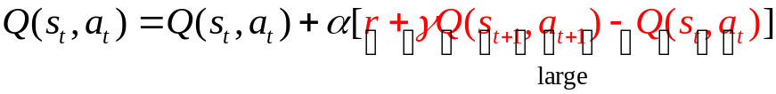
Prioritized Sweeping extension of Dyna
Improve model-based learning: Update useful states first
Store states in a priority queue
add queue to Dyna-algorithm
Research value: new for large, continuous
state-spaces and real setups
 |  | 4 | 3 | 2 | 1 | G
 |  |  | 4 |  | 2 | 1
 |  |  |  |  | 3 | 2
 |  |  |  |  | 4 | 3
 |  |  |  |  |  | 4
 |  |  | S
2D grid example
February 26, 2010
Notes:
Demands for the model-building technique:
Continuous states
Learning from few observations
Good accuracy (only in parts of state space?)
High dimensional problems
Efficient in CPU/memory usage (has to be applied in real time)

Slide 9
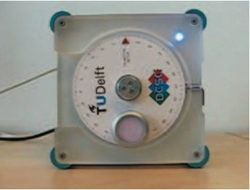



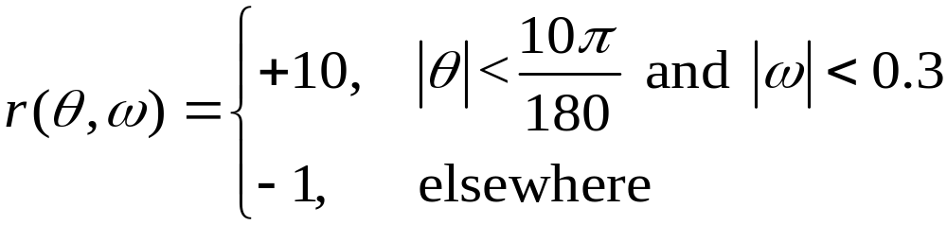
Simple learning problem:
DC-motor (simulation)
State space:
2 state-variables , 1 control variable
Goal:
move disc from a random initial state towards
Reward function:
February 26, 2010
Notes:
Demands for the model-building technique:
Continuous states
Learning from few observations
Good accuracy (only in parts of state space?)
High dimensional problems
Efficient in CPU/memory usage (has to be applied in real time)

Slide 10
DC-motor results learning speed
  3000 learning trials
  1 trial: 3 s, T_{s} = 0.01 s
  Dyna & PS: n = 1
  Dyna & PS learn faster than SARSA
  Adding PS to Dyna does not lead to speed improvement
  In general: Adding model-based experience increases learning speed
February 26, 2010
Notes:
Demands for the model-building technique:
Continuous states
Learning from few observations
Good accuracy (only in parts of state space?)
High dimensional problems
Efficient in CPU/memory usage (has to be applied in real time)

Slide 11
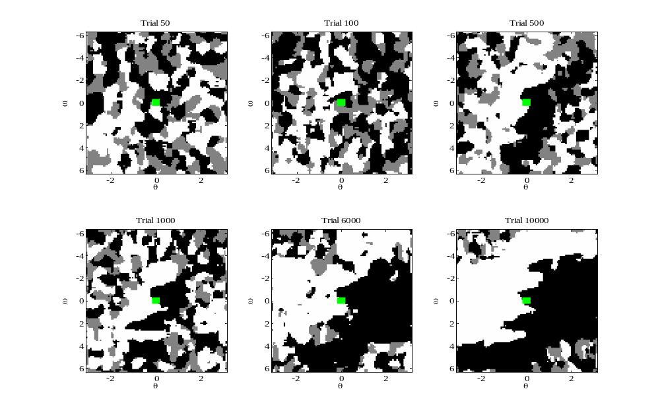
DC-motor results policy improvement
State-space:
θ : [-π, π] , ω : [-2π, 2π]
Control action:
 | +1
 | 0
 | 1
 | Goal region
February 26, 2010
Notes:
Demands for the model-building technique:
Continuous states
Learning from few observations
Good accuracy (only in parts of state space?)
High dimensional problems
Efficient in CPU/memory usage (has to be applied in real time)

Slide 12
Summary
  Increasing the number of experiences increases the learning speed
  Prioritized Sweeping is a way to direct computational effort to update useful states
Future work
  Compare reinforcement learning methods on more complex systems and on real setups
  Investigate how to implement Prioritized Sweeping on real systems
February 26, 2010
Notes:
I would like to conclude with an overview of the total project.
I will research two important aspects of PS:
Different techniques for building a state-transition model
Influence of PS on learning speed
Application on increasingly complex setups
Finally: Application of PS on robot Leo (Leo learns to walk?)

Slide 13
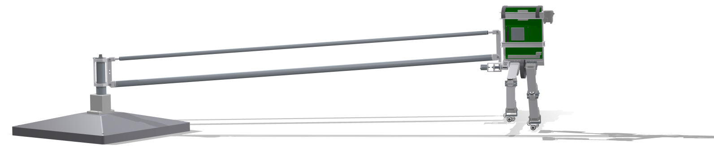
Questions, Comments, Suggestions?
February 26, 2010
Notes:
Are there any questions? Or suggestions?

